Slide 1


Driver Drowsiness Detection System (DDD)
Culture and science city
The higher institute of computer science and information technology
Supervised by :
DR. Marwa EL-enany
DR. Shaimaa Mahmoud

Slide 2
Agenda :-
1- Introduction.
2- System analysis.
3- Software and Hardware Tools.
4- AI solution.
5- Detection & Actions.
6- Live Demonstration & Future work.

Slide 3
Introduction

Slide 4
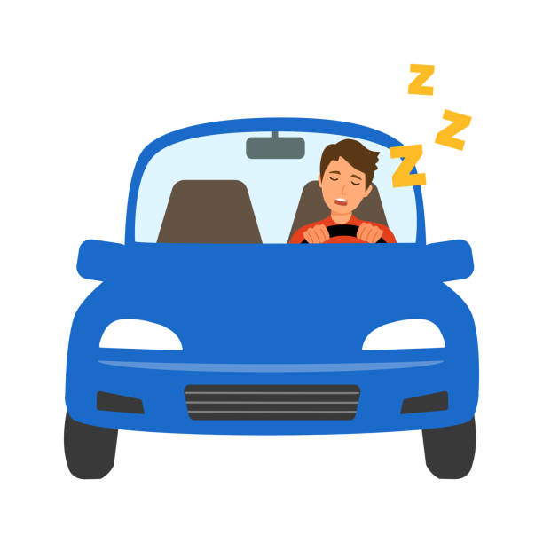
Brief notes
Consequences of falling asleep while driving (lack of sleep - diabetic coma ).
Using camera to capture the driver’s face in a real time environment.
Detecting drowsiness basically focuses on driver eyes (eye aspect ratio).

Slide 5
Problem statements
What
who
why
About 96% of all car accidents are caused by human mistakes like driving sleepiness.
Roads and human beings.
To save road security ,avoid putting people’s lives in danger and prevent countless mishaps.
where
how
when
In highways.
using some image processing and vision-based algorithms to detect drowsiness and the system alerts the driver and surrounding cars then stop the car if needed.
When drivers fall asleep or look down.

Slide 6
System Analysis

Slide 7
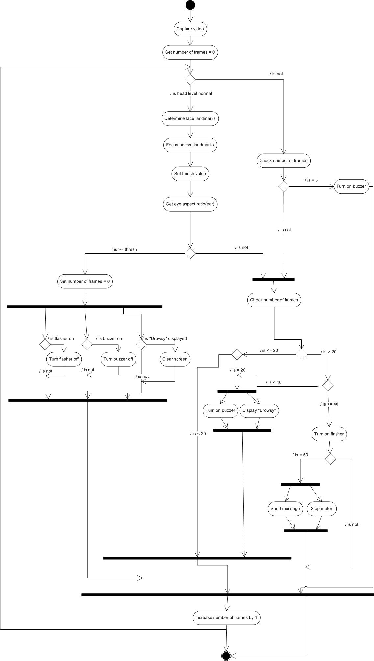
Activity Diagram
An activity diagram is a chart that captures the dynamic behavior of the system.

Slide 8
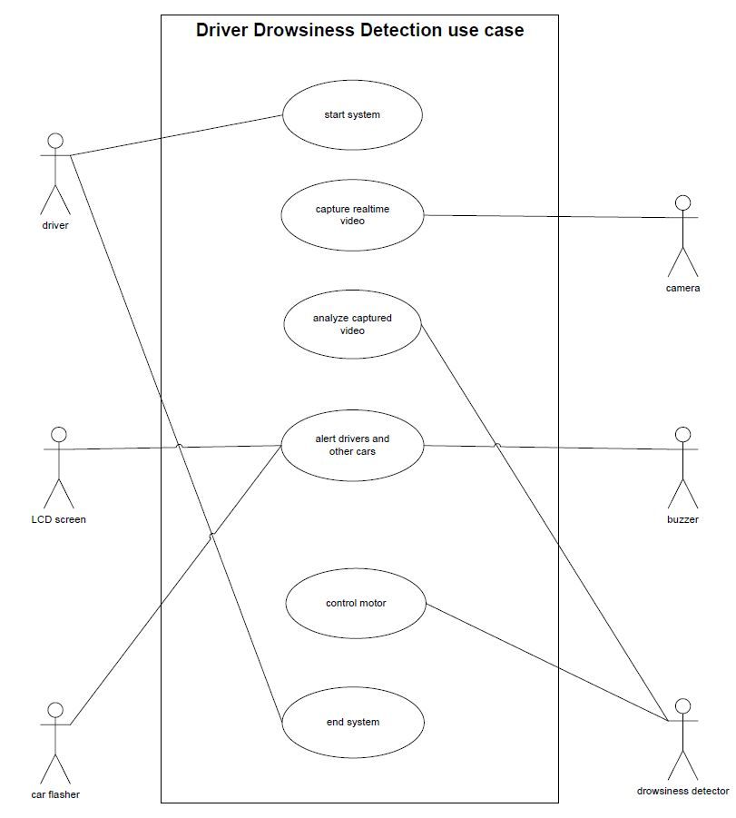
Use Cases Diagram
a use case diagram can summarize the details of your system's users (actors) and their interactions with the system.

Slide 9
Software & Hardware Tools

Slide 10
What Is software & Hardware Tools
1
Software tools
The necessary functionalities to develop and run the system, process system data, and manage communications.
2
Hardware tools
The necessary components, execute the software, and interact with the environment to provide alerts and feedback.

Slide 11


Software tools
1
Why python over some other languages. Here is why :
Ease of Use and Readability: syntax simplicity
Community Support and Documentation.
Integration Capabilities:
Large Ecosystem of Libraries: as OpenCv,dlib, SciPy etc….
Notes:
1-Cross platform

Slide 12

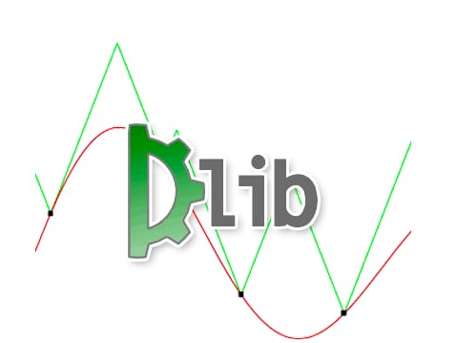
Libraries
OpenCv
Dlib
Optimized Performance:
Cross-Platform Compatibility:
Extensive Functionality:
Community and Documentation.
Machine Learning and Computer Vision Algorithms:
Efficiency and Performance: outperforming other libraries in terms of speed and accuracy.
Active Development and Research.
Notes:
OpenCv(1): offering high-performance image processing and video analysis in real-time applications.
OpenCv(2): rich set of functions for (image manipulation, object detection, face recognition), and more.
DLIB 1- offers algorithms for face detection, facial landmark prediction, object tracking, and deep learning.
Dlib 2- in face detection and facial landmark localization tasks.

Slide 13
Libraries
Imutils
Scipy
Utility functions for simplifying image processing tasks
Time- saving
Ease of Integration with OpenCv and other libraries.
Used for scientific and technical computing, specifically to calculate the Euclidean distance
ideal for complex calculations required in machine learning and computer vision tasks.
Notes:
OpenCv(1): offering high-performance image processing and video analysis in real-time applications.
OpenCv(2): rich set of functions for (image manipulation, object detection, face recognition), and more.
DLIB 1- offers algorithms for face detection, facial landmark prediction, object tracking, and deep learning.
Dlib 2- in face detection and facial landmark localization tasks.

Slide 14
Hardware tools
2
Camera
Microcontroller
Alert System
PC
Utilized to capture real-time video frames of the driver's face, ensuring continuous monitoring.
Consists of a different actuators to alert the driver when drowsiness found
(Buzzer, Flusher, Motor-driver)
Running the Python script, capturing video from the webcam, processing the frames
ESP microcontroller with integrated Wi-Fi and Bluetooth, used to receive commands and control external alert devices.

Slide 15
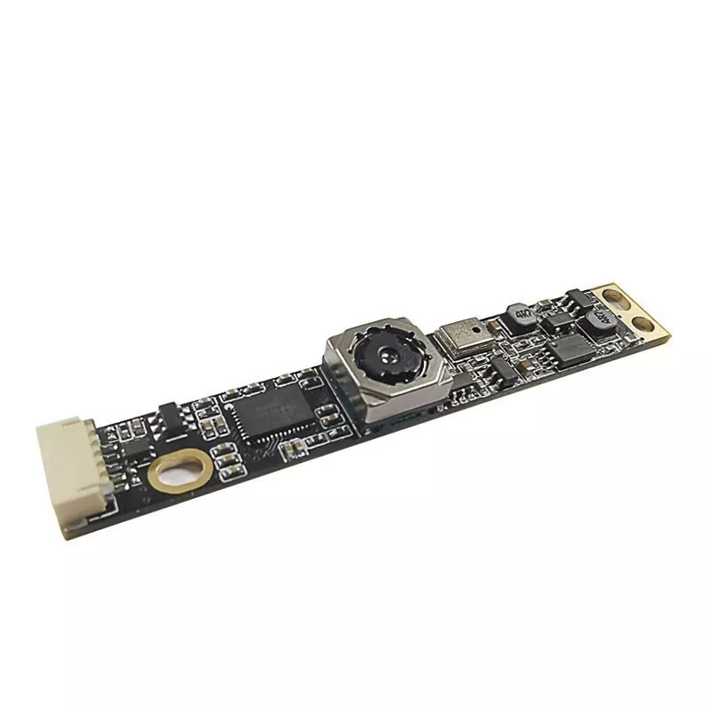
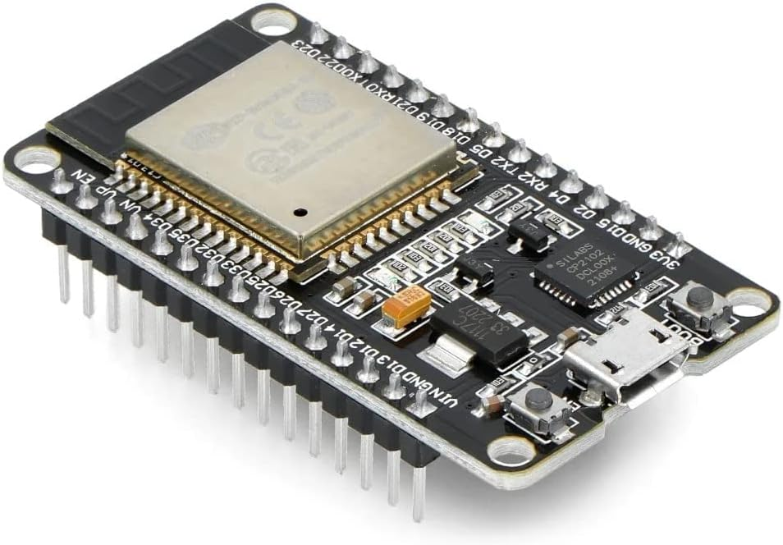
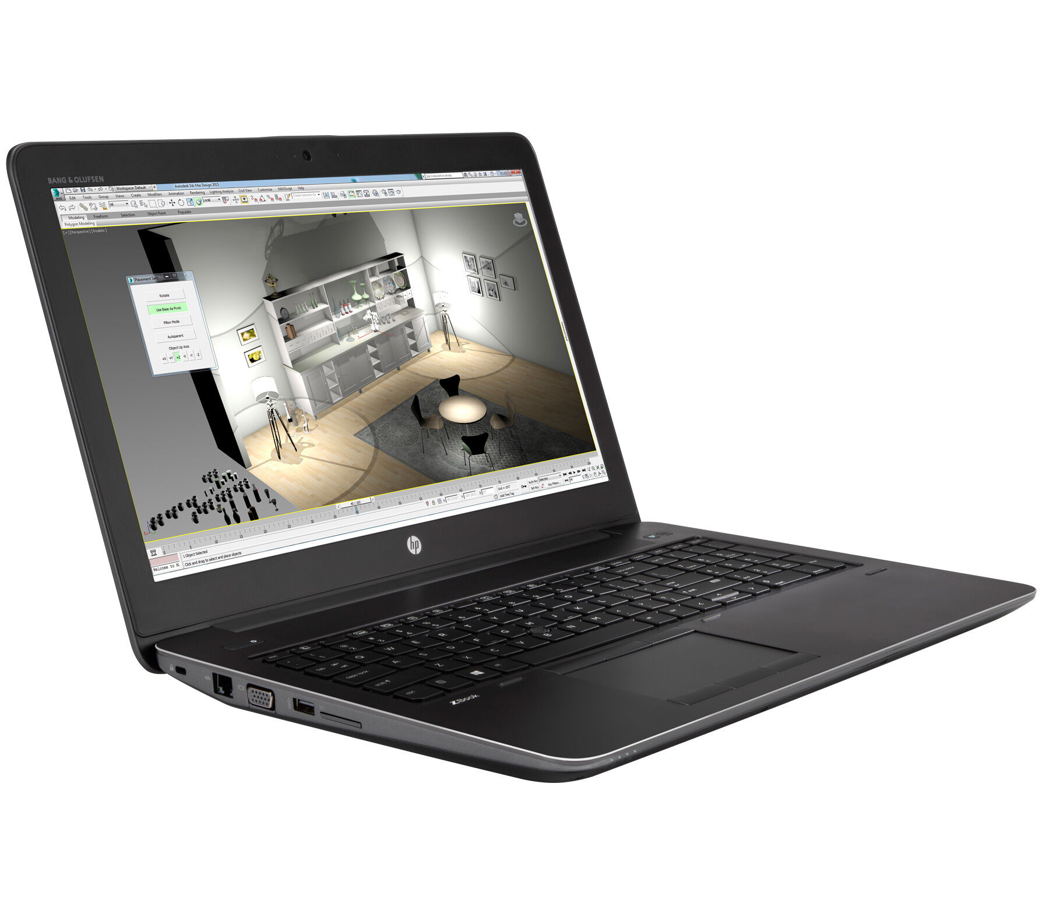
Camera sensor
Webcam : Video capture at various resolutions up to 1280 x 720 resolution (720p) and up to 30 fps
Mobile Camera : 16 MP, f/2.5, (wide), Video capture 1080p@30fps
Utilized to capture real-time video frames of the driver's face.
ESP 32 Microcontroller
ESP32 :input/output (I/O) pins (34 physical GPIO pins). it comes with
integrated Wi-Fi and Bluetooth,
flash memory, power management,
PC
Laptop : Provides the necessary computational power to run complex image processing and machine learning algorithms in real-time.
Notes:
ESP32 Can be programmed using C++, C, and python.
PC: Captures real-time video feeds from a connected camera. It handles, image processing, running detection algorithms, and communicating with external hardware components.

Slide 16
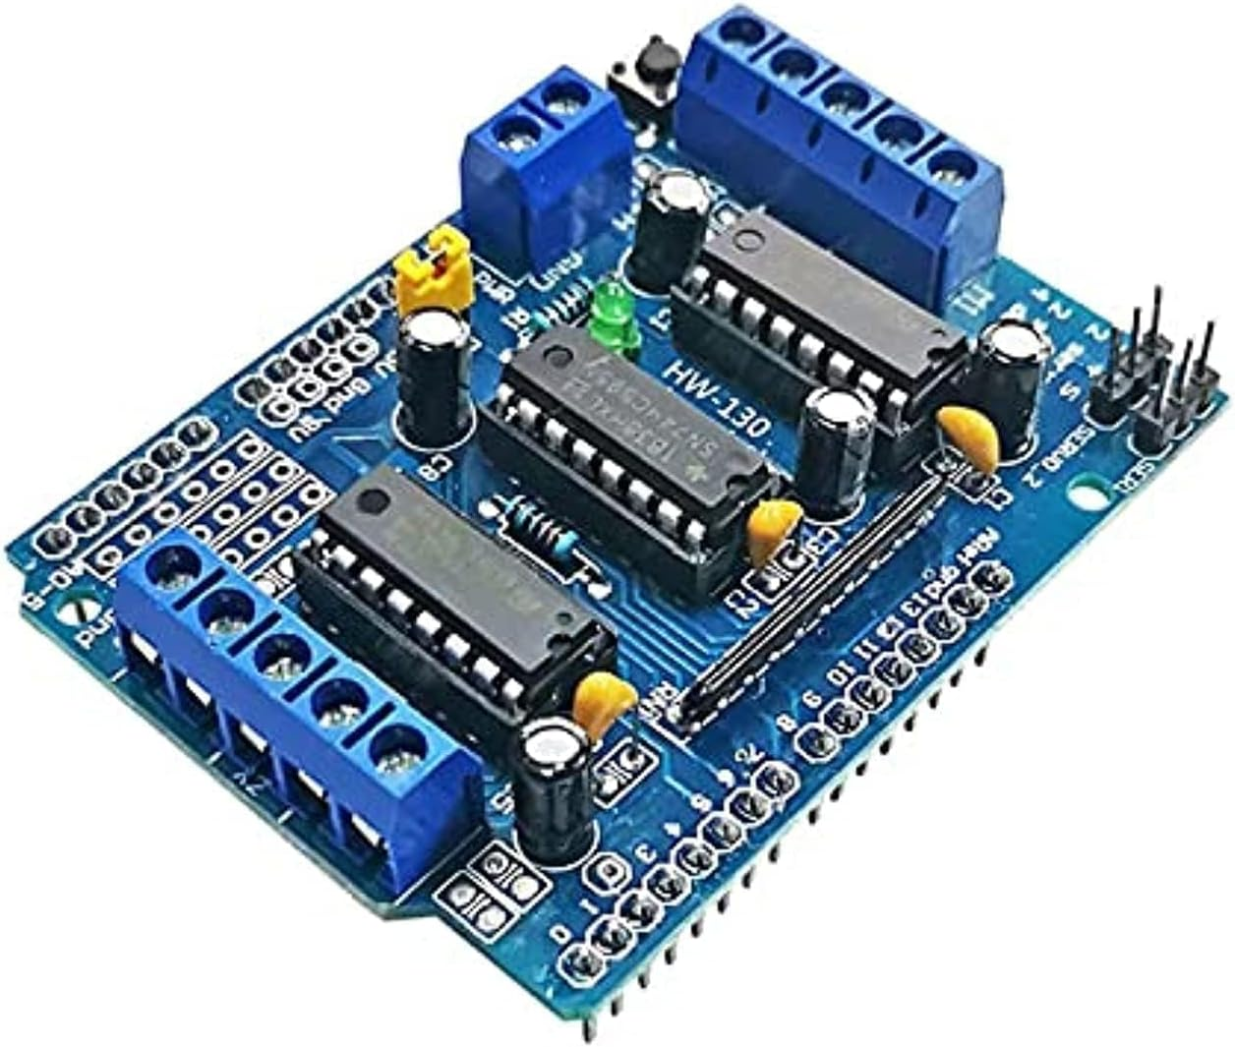
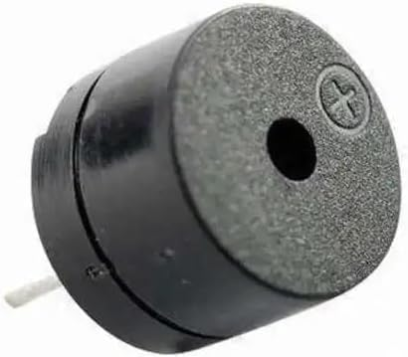
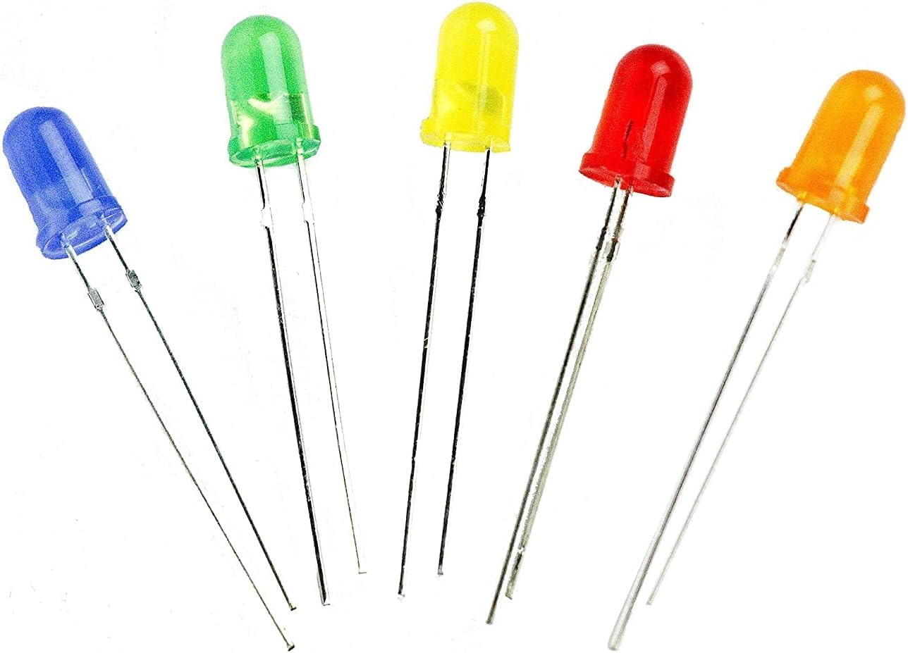
The Alert Actuators
Motor Driver
Coordinate the performance of an electric motor. Selecting forward or reverse rotation, selecting and regulating the speed. L293D shield can drive 4 DC motors at the same time.
Buzzer
Used to generate auditory alerts when drowsiness is detected. The frequency range is 3,300Hz.
LED
Likely a visual alert mechanism, such as flashing lights, to get the other driver's attention.

Slide 17
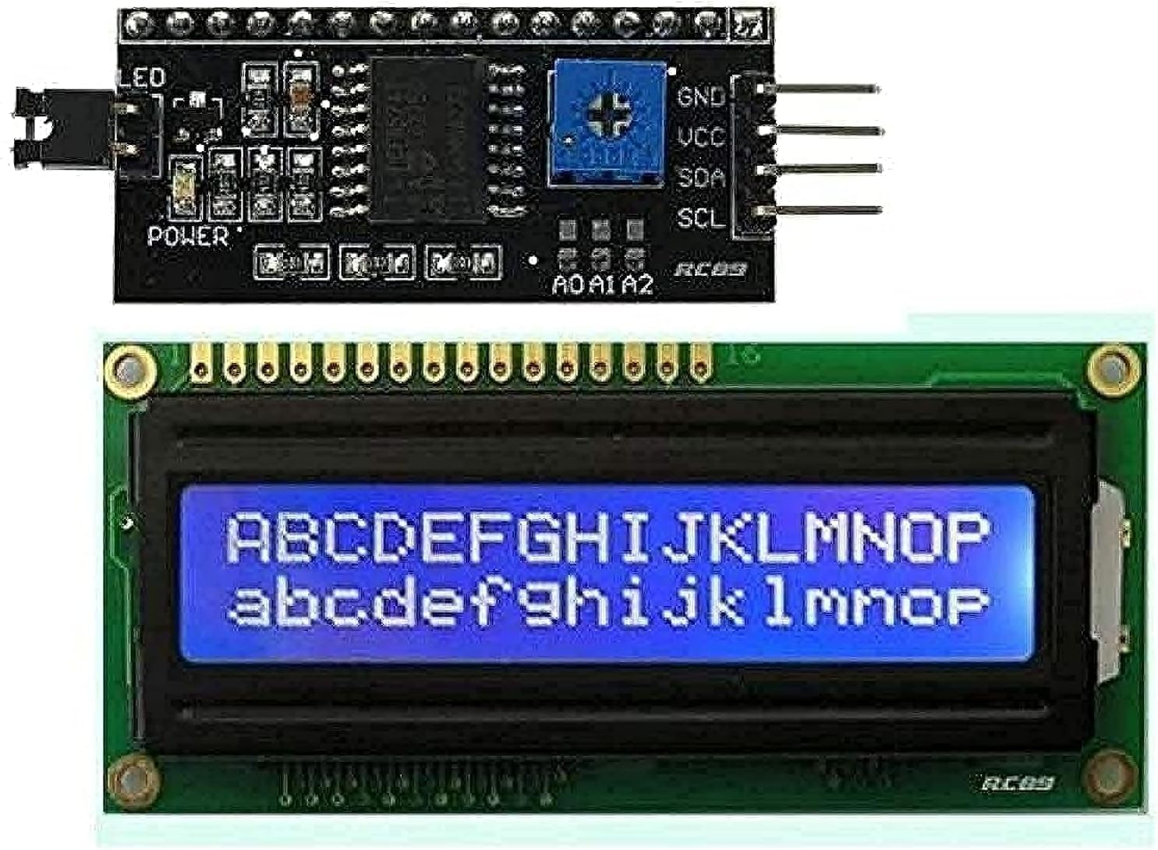
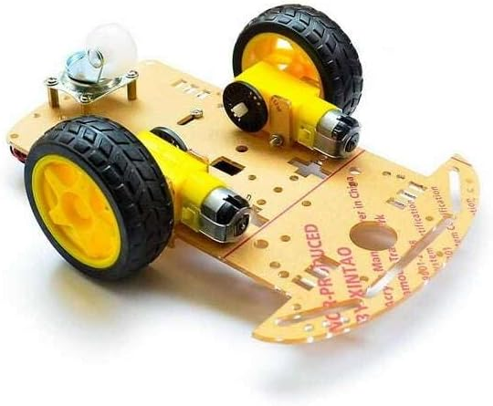
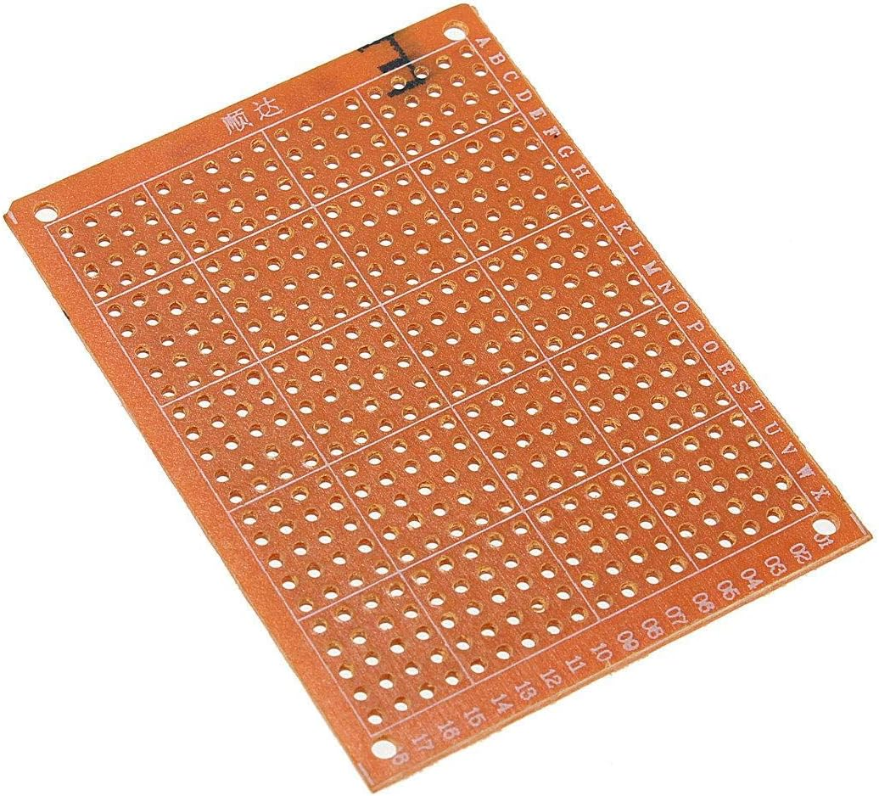
LCD Screen
Display warnings or messages to inform the other drivers of the drowsiness status and provide instructions or alerts.
2WD Robot
The 2WD smart robot car chassis kit is an easy to assemble and use robot
chassis platform.
PCB Board
is a provider of electrical connections for electronic components.

Slide 18



Used Technologies
Shape-predictor –landmarks68
Machine learning
The model used to predict drowsiness
computer vision increasingly relies on machine learning techniques like supervised, supervised, deep learning
Computer Vision
AI
enables computers to understand visual information
Object Detection
Image Segmentation
Facial Recognition
3D Vision
Artificial Intelligence (AI) is a broad field encompassing various subfields and disciplines aims to create systems capable of performing tasks requires human intelligence.

Slide 19
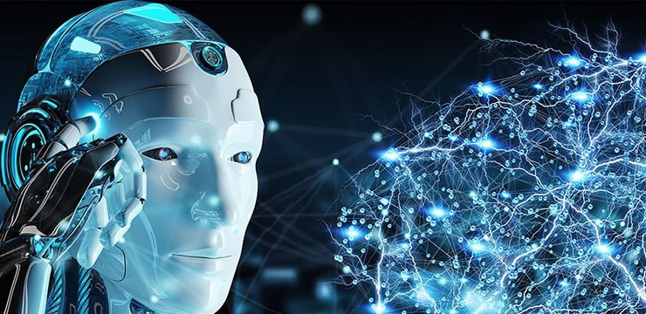
AI Solution:
Using AI, we can develop a Drowsy Driver Detection System that monitors the driver's facial features to detect signs of drowsiness and alert the driver.

Slide 20
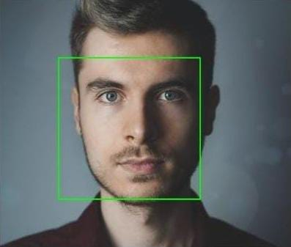
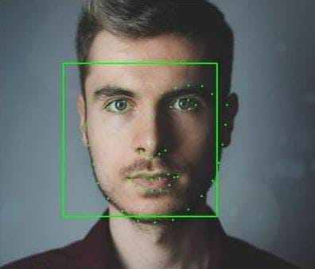
Two method:-
1-Face detection
2- Landmark detection

Slide 21
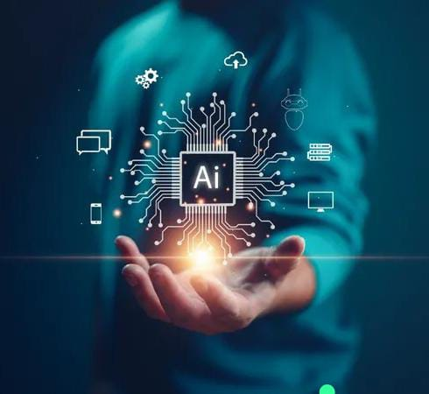
1-Face detection (Frontal face detector )
Dlib's frontal-face-detector function detects front faces with high accuracy
Accuracy: 85% to 95%.

Slide 22
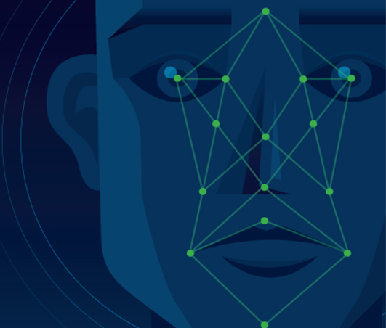
2-Models for landmark detection
Haar Cascades
Shape Predictor 68 Face Landmark
Convolutional Neural Networks (CNNs)

Slide 23
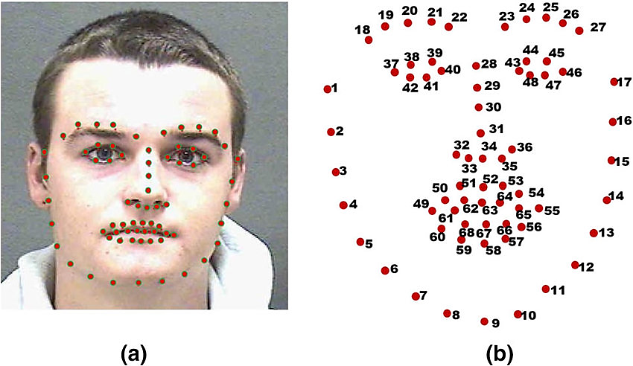
Shape Predictor 68 Face Landmark
Real-time efficiency
Robustness
Accuracy
Flexibility.

Slide 24
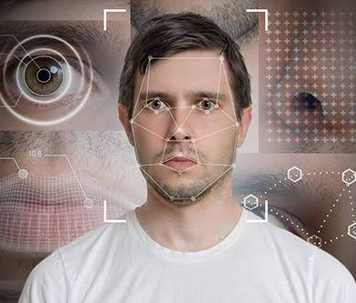
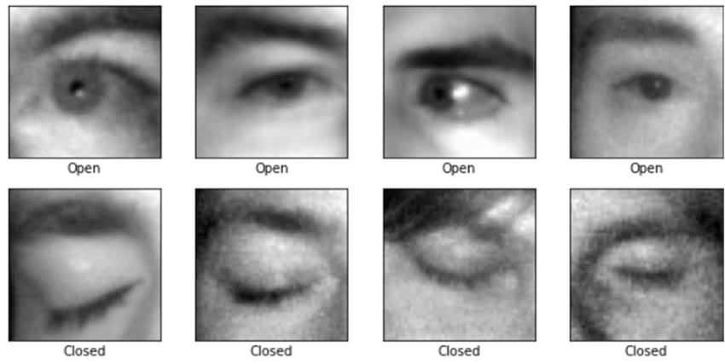
Shape Predictor 68 Face Landmark
Trained using the iBug 300W dataset , which contains approximately 300 faces , contains 68,000 images.
Detects 68 specific points on the face, categorized into 7 features
(Mouth, Right Eyebrow, Left Eyebrow, Right Eye, Left Eye, Nose, Jaw.)
For this project, we focus primarily on the eyes.

Slide 25
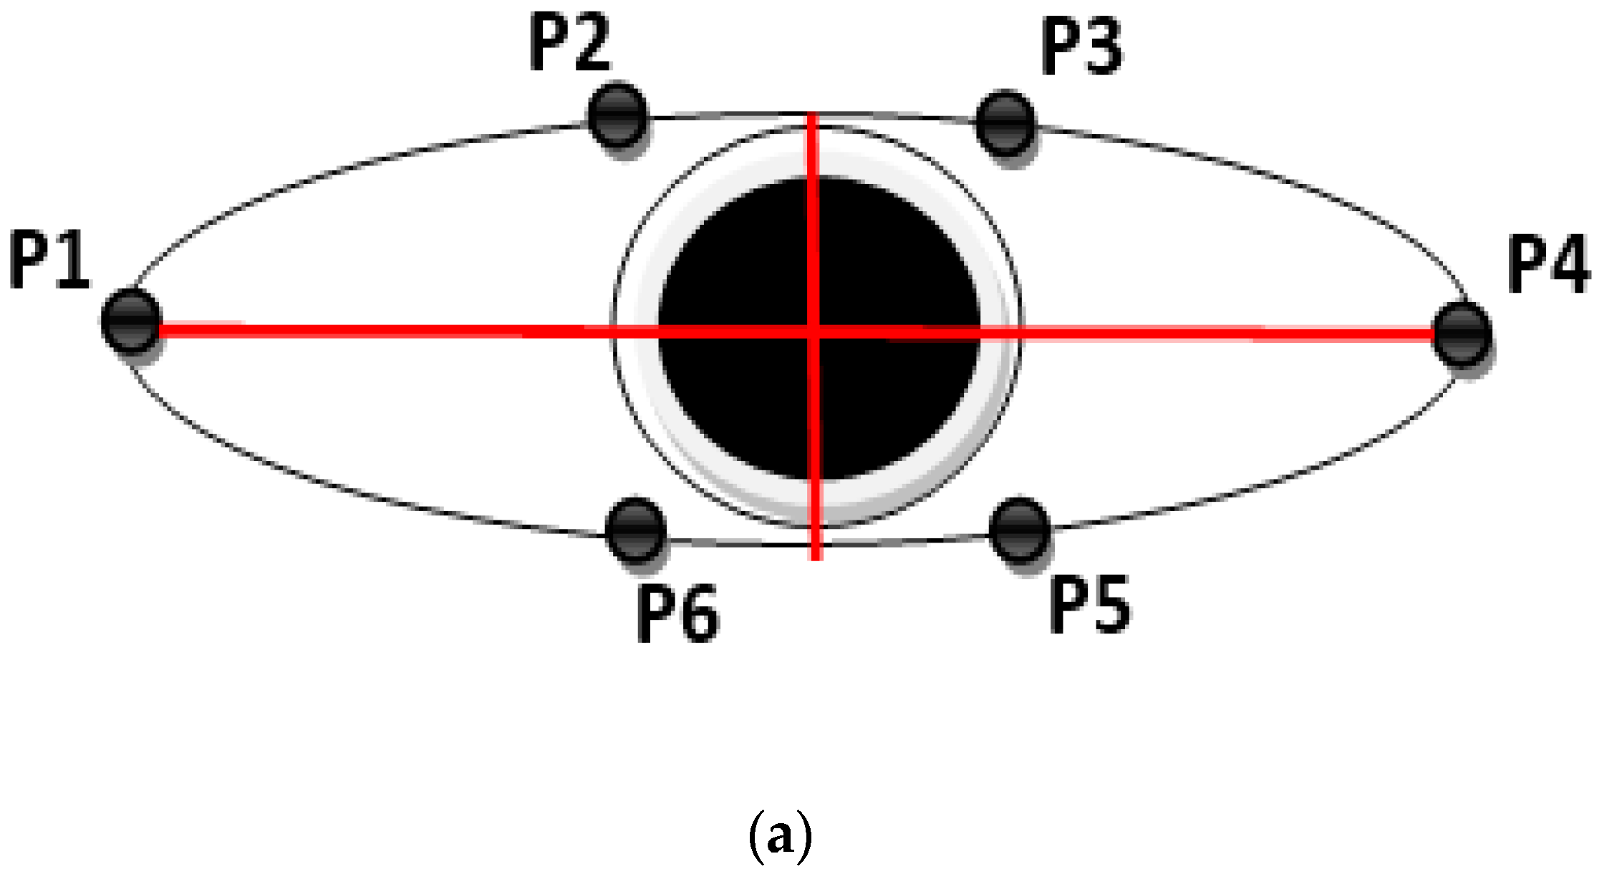
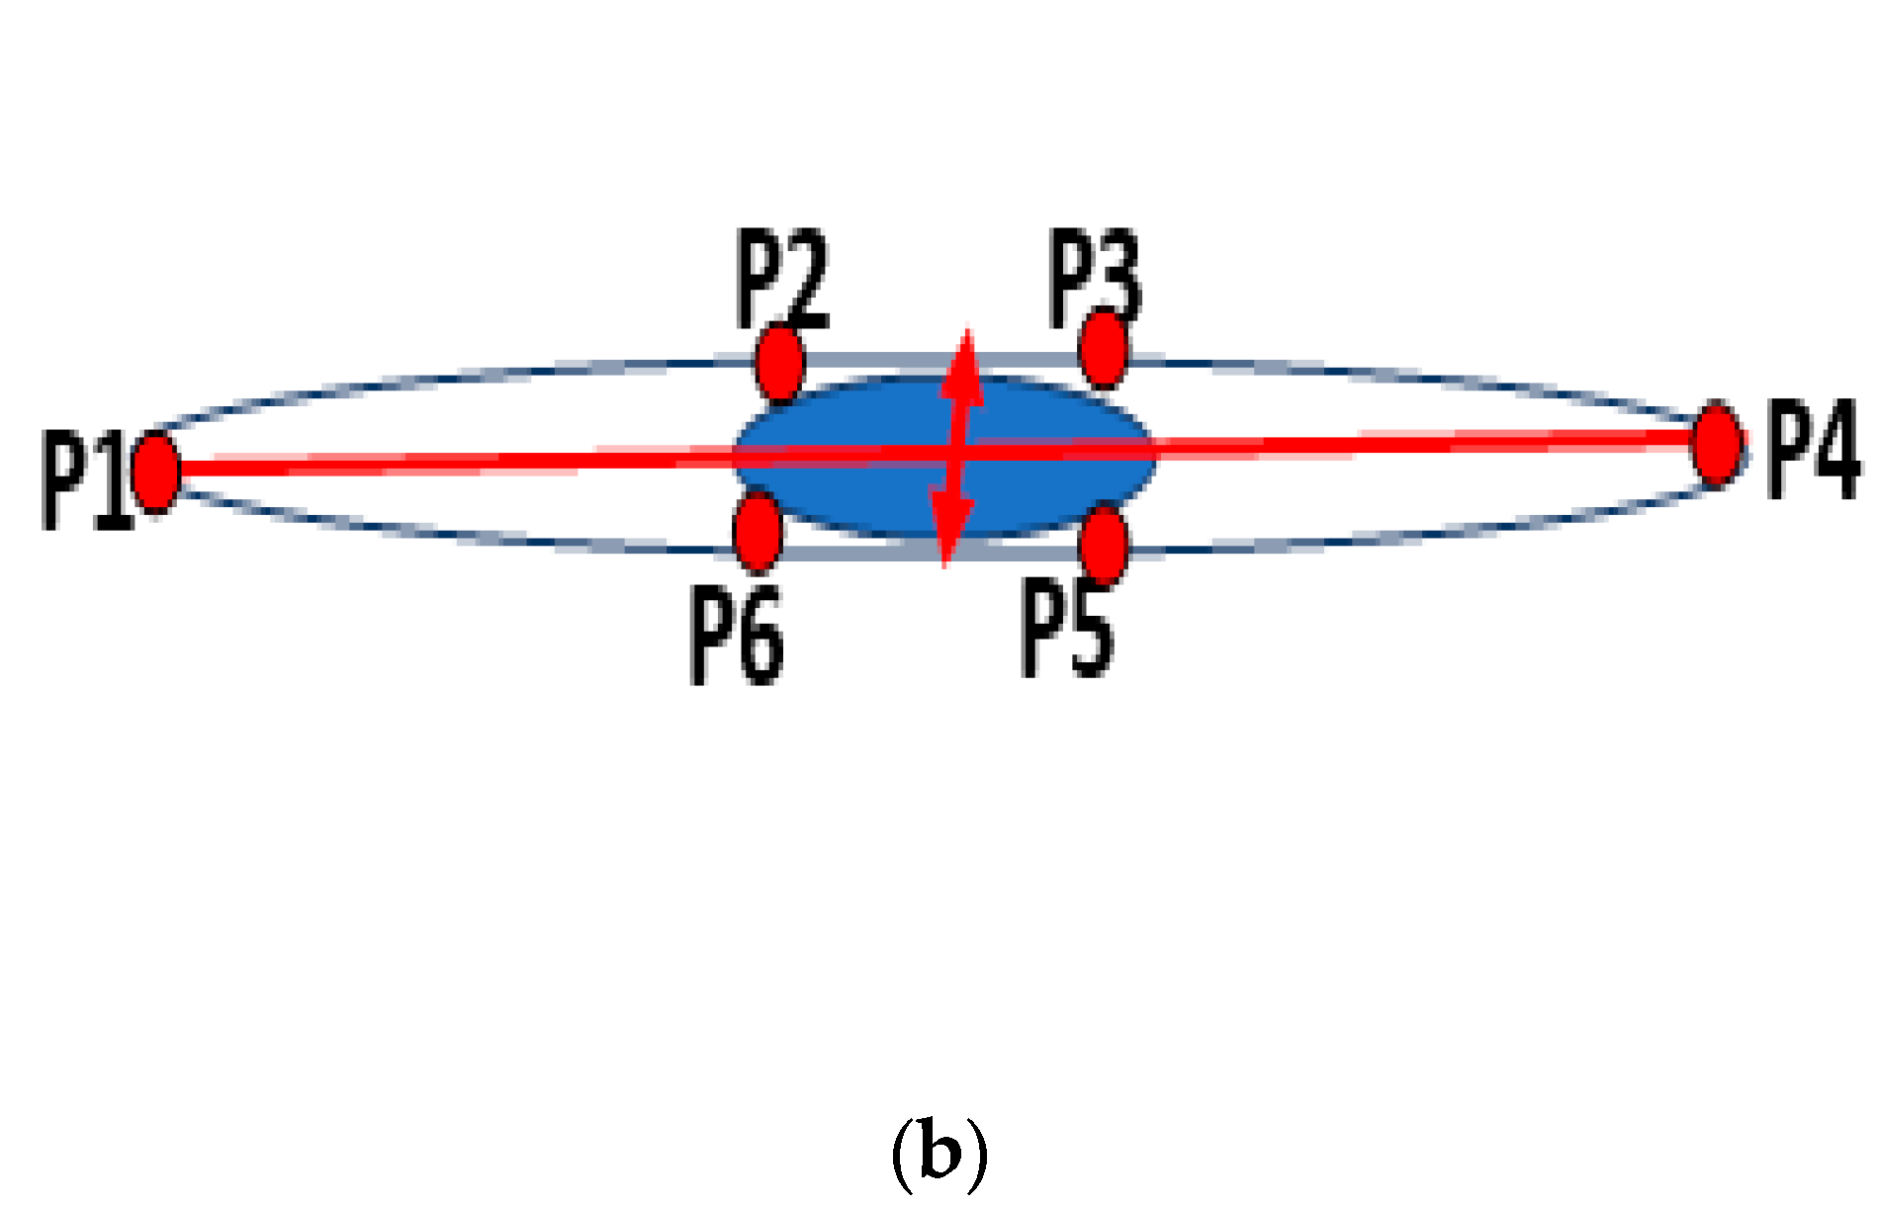
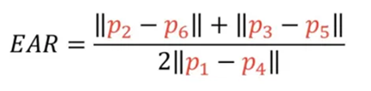
Detection phase
Definition of EAR and its significance in drowsiness detection.
Mathematical formula for EAR:
Visual representation of eye landmarks and how EAR is computed.

Slide 26
DDD Logic flow
Continuous monitoring of EAR in a loop.
Threshold determination (e.g. thresh=0.25) for drowsiness detection.
Incrementing a flag counter when EAR falls below the threshold.
Gradual escalation of alerts (buzzer, flasher) based on flag value.
Triggering actions (stopping motors & rear screen) when drowsiness persists.

Slide 27
Action Hierarchy
Level 1: Auditory Alert via Buzzer
Level 2: Visual Alert
Visual Alert via LED Flashing
Visual Alert via Rear Screen
Level 3: Emergency Notification
Level 4: Vehicle Control Actions

Slide 28
Action Hierarchy
Level 1: Auditory Alert via Buzzer
The system triggers an auditory alert through a buzzer to grab the driver's attention. This alert serves as an immediate warning to address drowsiness. Its goal is to prompt the driver to take corrective action.

Slide 29
Action Hierarchy
Level 2: Visual Alert
Visual Alert via LED Flashing:
If the driver remains drowsy, the system escalates the alert to a visual one.
LEDs (Light Emitting Diodes) placed within the vehicle flash to further warn the surrounding traffic.

Slide 30
Action Hierarchy
Level 2: Visual Alert
Visual Alert via Rear Screen:
The system displays a visual alert on a dedicated screen.
This screen is positioned externally, visible to other drivers on the road.
It shows an easily recognizable message, such as “Stay Alert!” or “Driver Is Drowsy” to convey that the driver is drowsy.

Slide 31
Action Hierarchy
Level 3: Emergency Notification:
The system incorporates a crucial communication feature that leverages WhatsApp to enhance safety and provide timely alerts.
By integrating WhatsApp messaging, When drowsiness is detected, This recipient could be a family member, friend, or emergency contact.

Slide 32
Action Hierarchy
Level 4: Vehicle Control Actions
In critical situations, the system takes control actions to prevent accidents.
Examples of actions include reducing the vehicle’s speed or activating emergency braking.

Slide 33
Live demonstration !

Slide 34
Conclusion
With the drowsiness detection system, the system aim to safeguard the driver's life by providing timely alerts and necessary actions to prevent accidents.
Thus, we strive to enhance road safety through our solution.

Slide 35
Future work
Blink Frequency Analysis
Mobile App Feature
Voice Alerts and Interaction

Slide 36
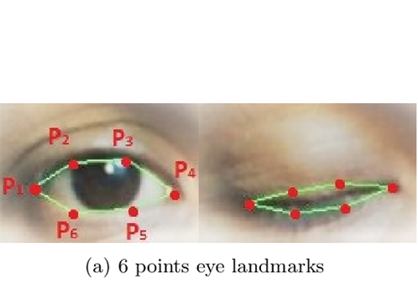
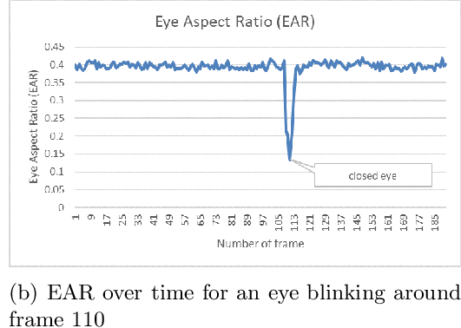
Blink Frequency Analysis
Blink Detection:
Analyze blink frequency to detect early drowsiness.
Use eye aspect ratio (EAR) to detect blinks.
Benefits:
Provides an additional metric for drowsiness detection.
Enhances overall detection accuracy.

Slide 37
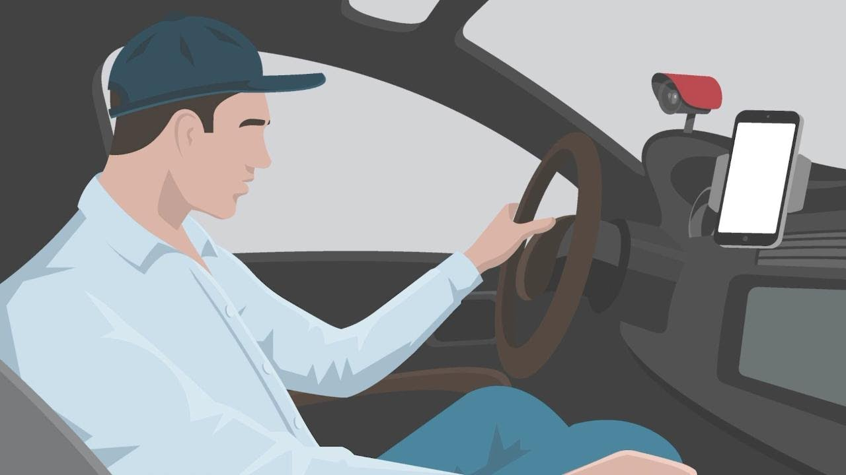
Mobile App Feature
Real-time Monitoring:
Display real-time alerts and system status on the mobile app.
Visualize drowsiness detection data with graphs and notifications.
User Controls:
Enable/disable specific features remotely.
The mobile app will send the driver's location to relatives when drowsiness is detected.

Slide 38
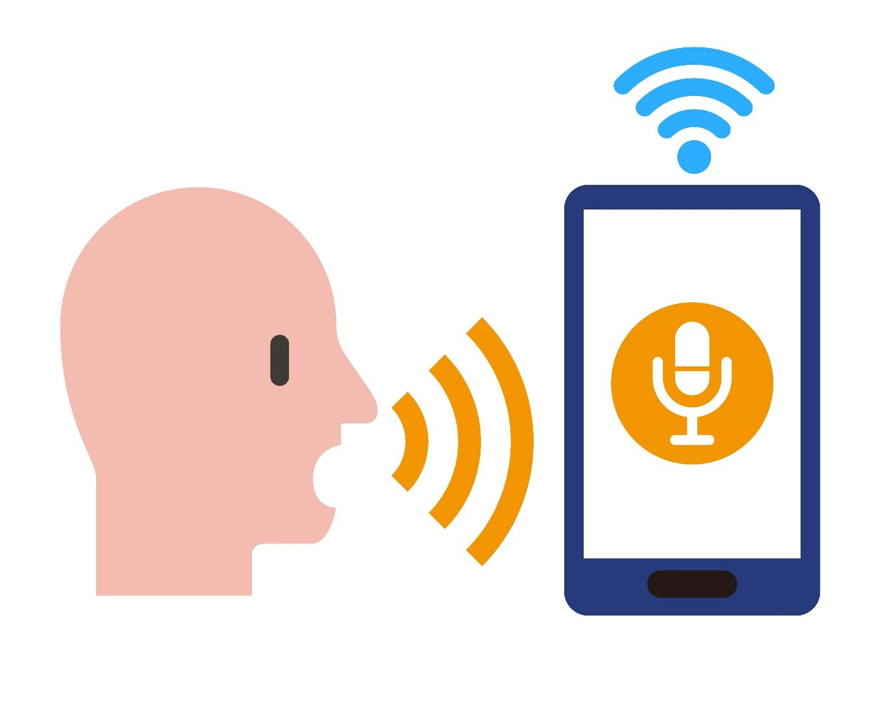
Voice Alerts and Interaction
Voice Alerts:
Integrate speech libraries to provide voice alerts for different levels of drowsiness.
Customizable alert messages based on the detected condition.
Voice Commands:
Enable voice commands to control the system (e.g., start/stop detection).
Use libraries like Google Speech Recognition or Amazon Alexa for voice interaction.

Slide 39
Thanks!

